Slide 1
IDP template guidelines
October 2018

Slide 2
What is an IDP?
Individual Development Plans (IDPs) are a customized roadmap for your development and goals that will enable you to make the most of your EL Journey and your assessment results.
The IDP process will guide you to reflect on your skills and your career aspirations, and translate those into specific actions toward achieving new skills and professional goals.
While self-reflection is a great exercise, development plans also need to be created in consultation with your mentor and RA with their feedback and support to enhance your development journey.
Once you have filled in your IDP template, please ensure you share the IDP and have a discussion with your RA and your mentor for their review and inputs.
While we will be collecting the IDP for documentation, please remember that the document is your Individual Development Plan and you need the own the document to ensure your development journey is on track

Slide 3
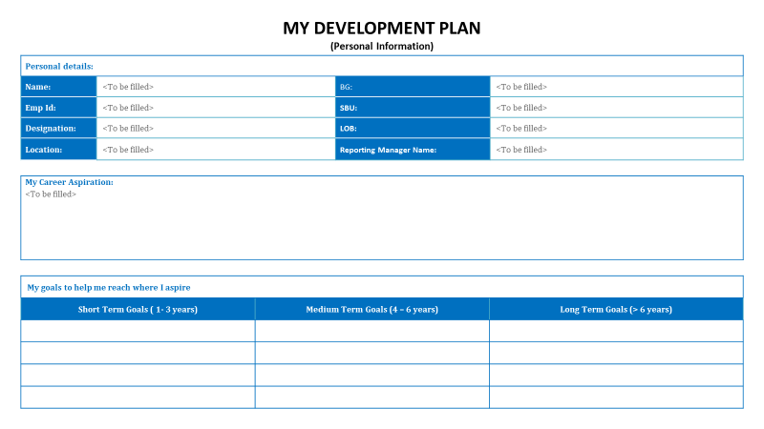
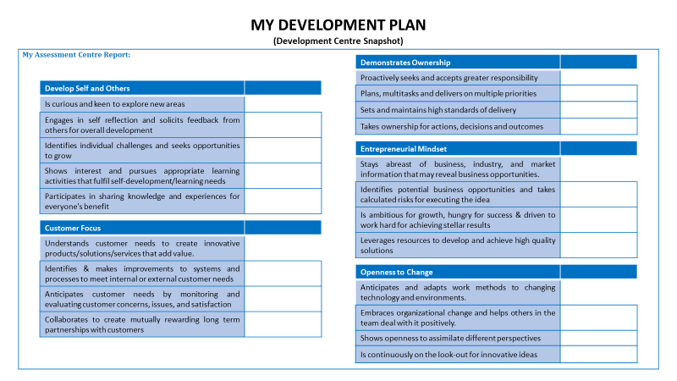
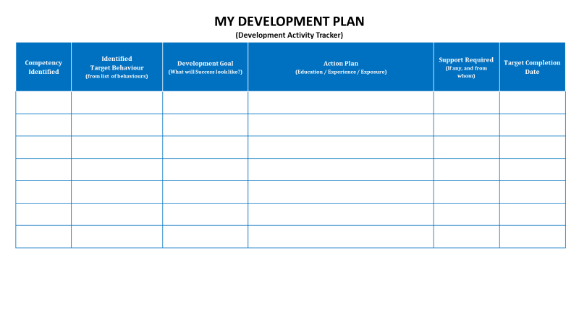
Knowing your IDP Template
Your IDP’s have 3 sections: Personal Information, Development Centre Snapshot and Development Activity Tracker. These have been designed to aid you, as well as your conversations with your mentor and your RA
The IDP has to be drafted in conjunction with your Development Center Report that has already been shared with you. The following slides will provide additional details for each section
Personal Information
Development Centre Snapshot
Development Activity Tracker

Slide 4
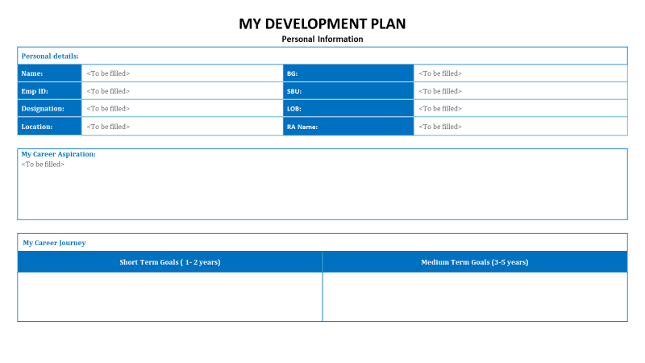
Knowing your IDP Template | Personal Information
Personal information and Demographic details
Articulate your long term aspiration in manner that can also help your mentor and RA aid you in the development. Be as specific as possible
These are the goals that you are seeing as the stepping stones to reach your aspirations

Slide 5
Knowing your IDP Template | Development Center Snapshot
Please use your development center report to fill in the areas here. Use the legend:
ND : Needs Development;
ES : Emerging Strength;
IS : Identified Strength
This section will act as quick reference guide to your development center feedback for you as well as aid you in your conversations with your RA and mentor
Please use this opportunity while filling this in to reflect back to your feedback session, this will help you detail out your action plan for development

Slide 6
Knowing your IDP Template | Development Activity Tracker
Pick out Competency names and target behaviors based on Development Center report and your feedback session
Articulate the change in behavior you are targeting based on the identified area. Feel free to customize it to your job context
You may refer to the Development Guidelines section of you assessment center report.
However, please remember that it is only an indicative list to give you a flavor, and you may create your own development actions as long at they are specific, trackable and time-bound
You can include multiple activities for the same development area

Slide 7
Next Steps
We will set-up and share helpdesk slots where we will keep a bridge call open take any queries and doubts on the template
Please ensure you fill out your IDP and have your first draft ready by 10th October 2018.
We have scheduled a detailed session with your RA’s on the IDP and we encourage you to have a discussion on your IDP with them after the session happens on 10th October 2018
You will also have your mentoring kick-off on the 13th October 2018 where you will schedule your first session with your SL mentors, where you can share your IDP with them
Please ensure that your IDP is complete including inputs from your RA before your first mentoring session.

Slide 8
Thank You

